Slide 1
UNCW Navigator
By: Johnathan Smith

Slide 2
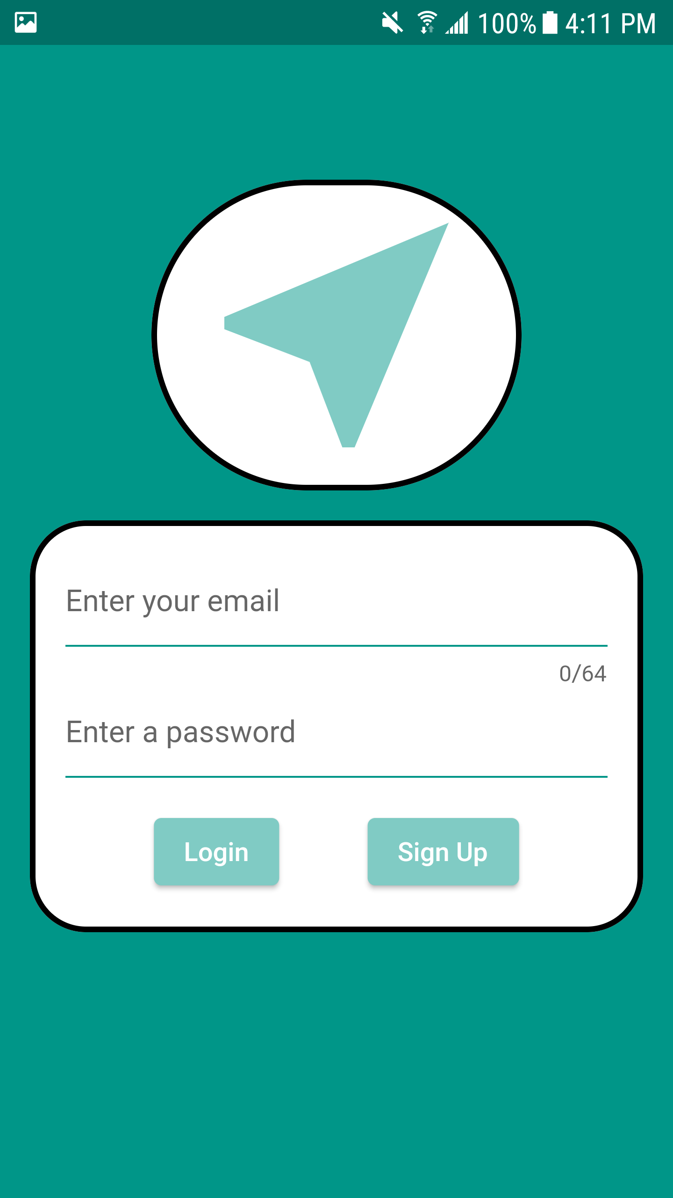
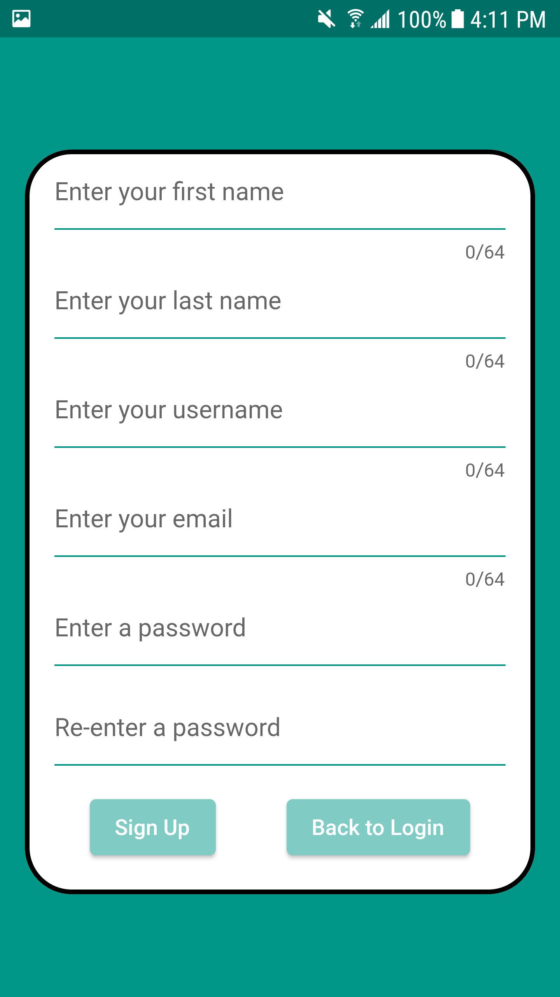
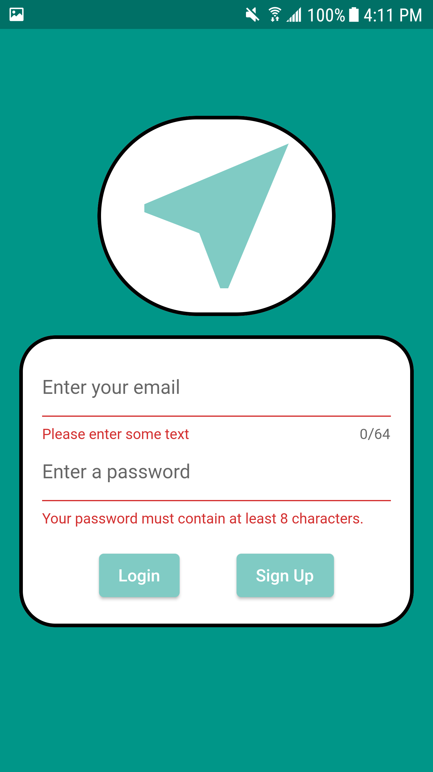
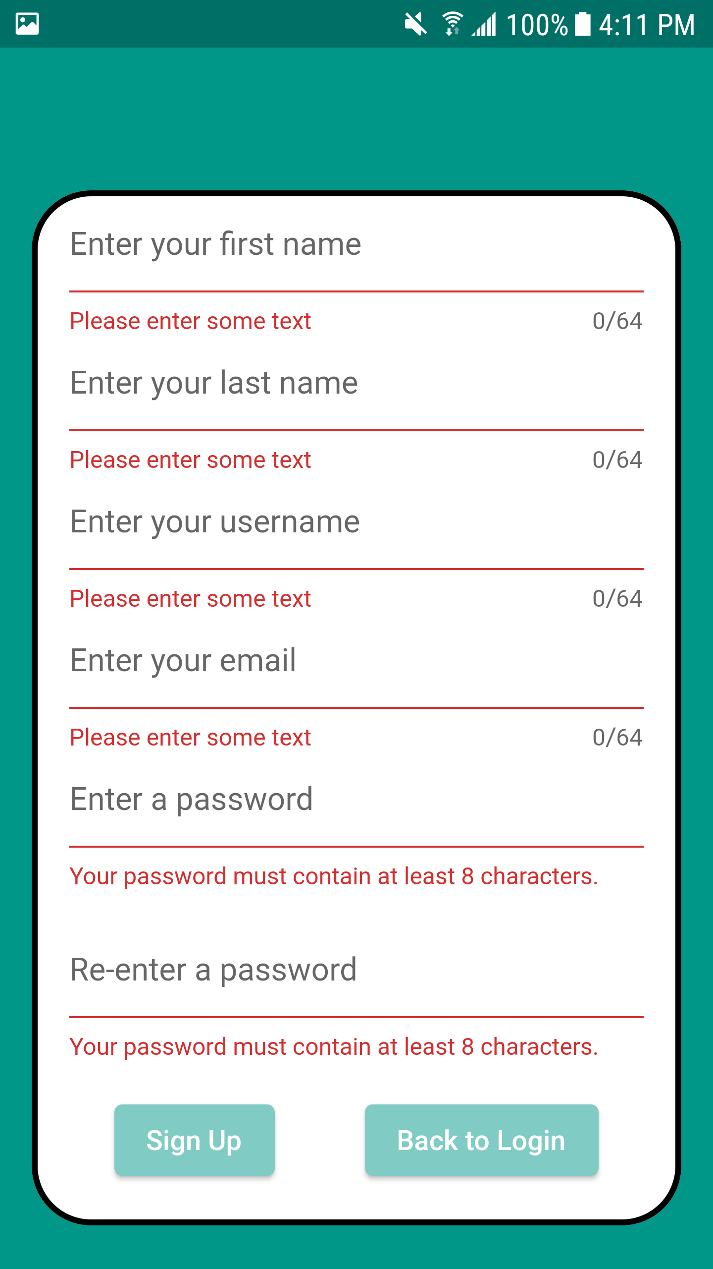
Login screen to access the app
Sign up screen to create an
Account for the app
Authentication for login
Authentication for Sign up

Slide 3
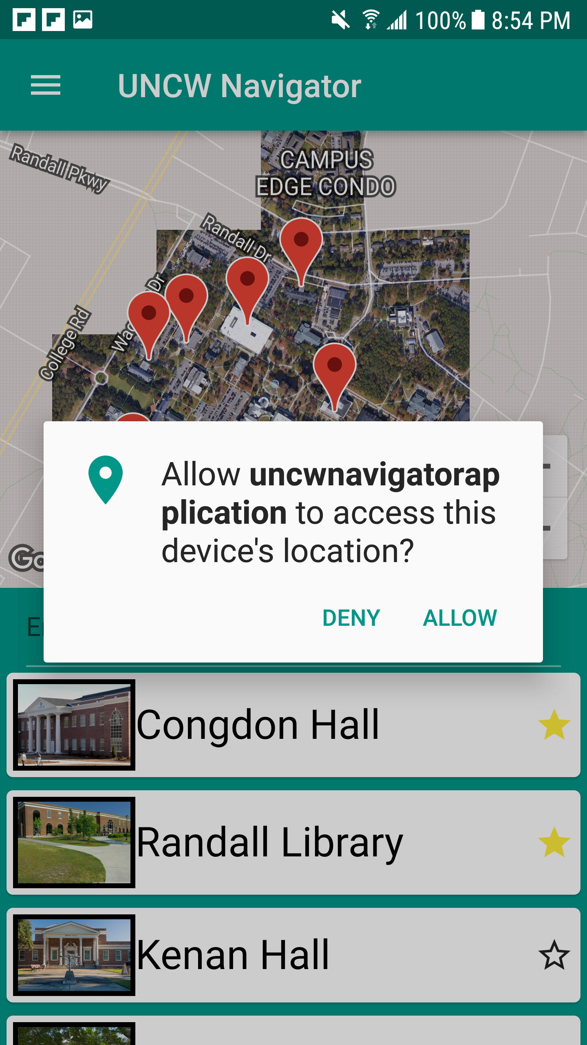
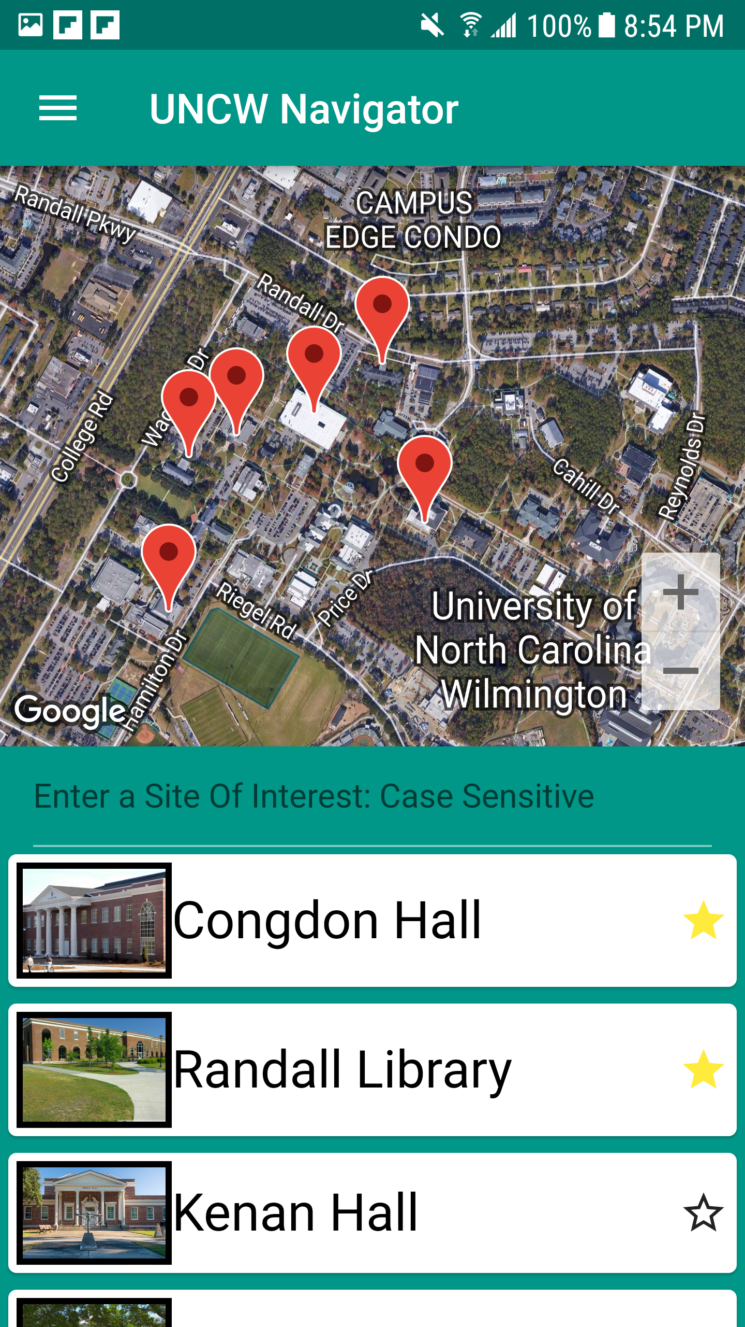
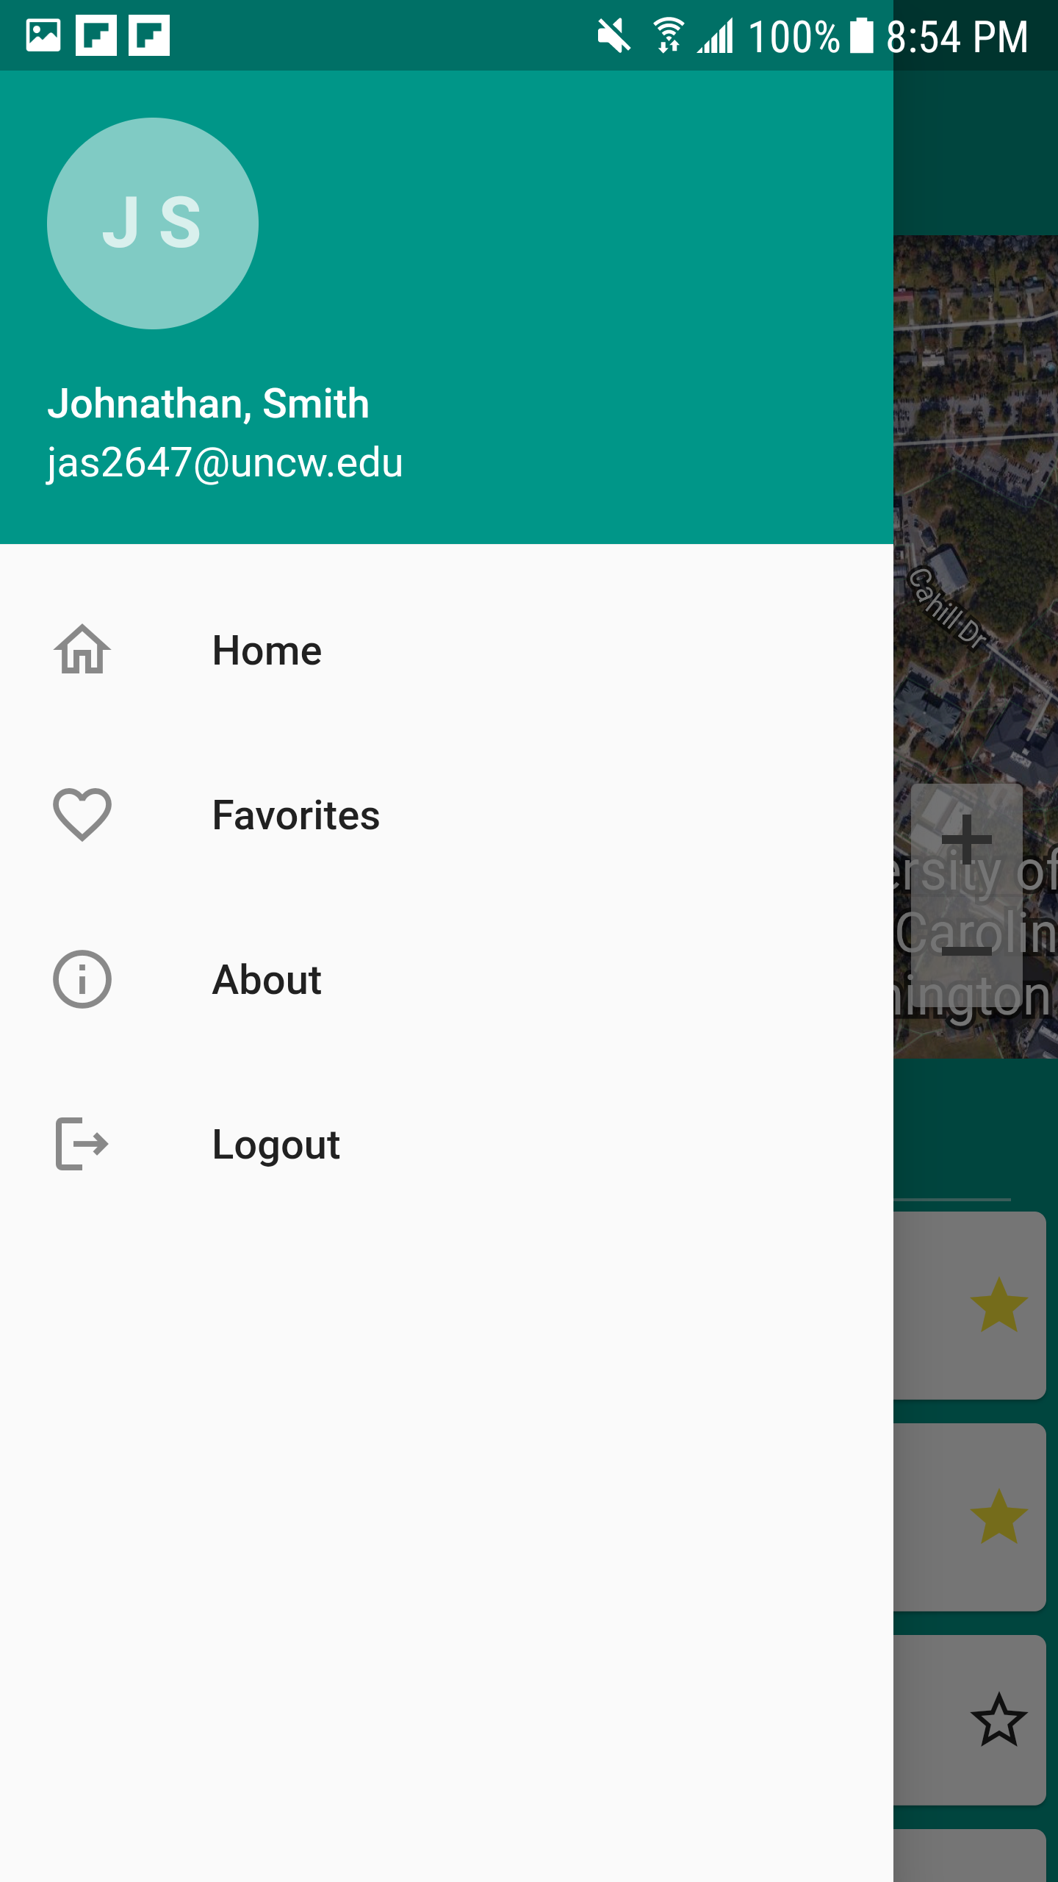
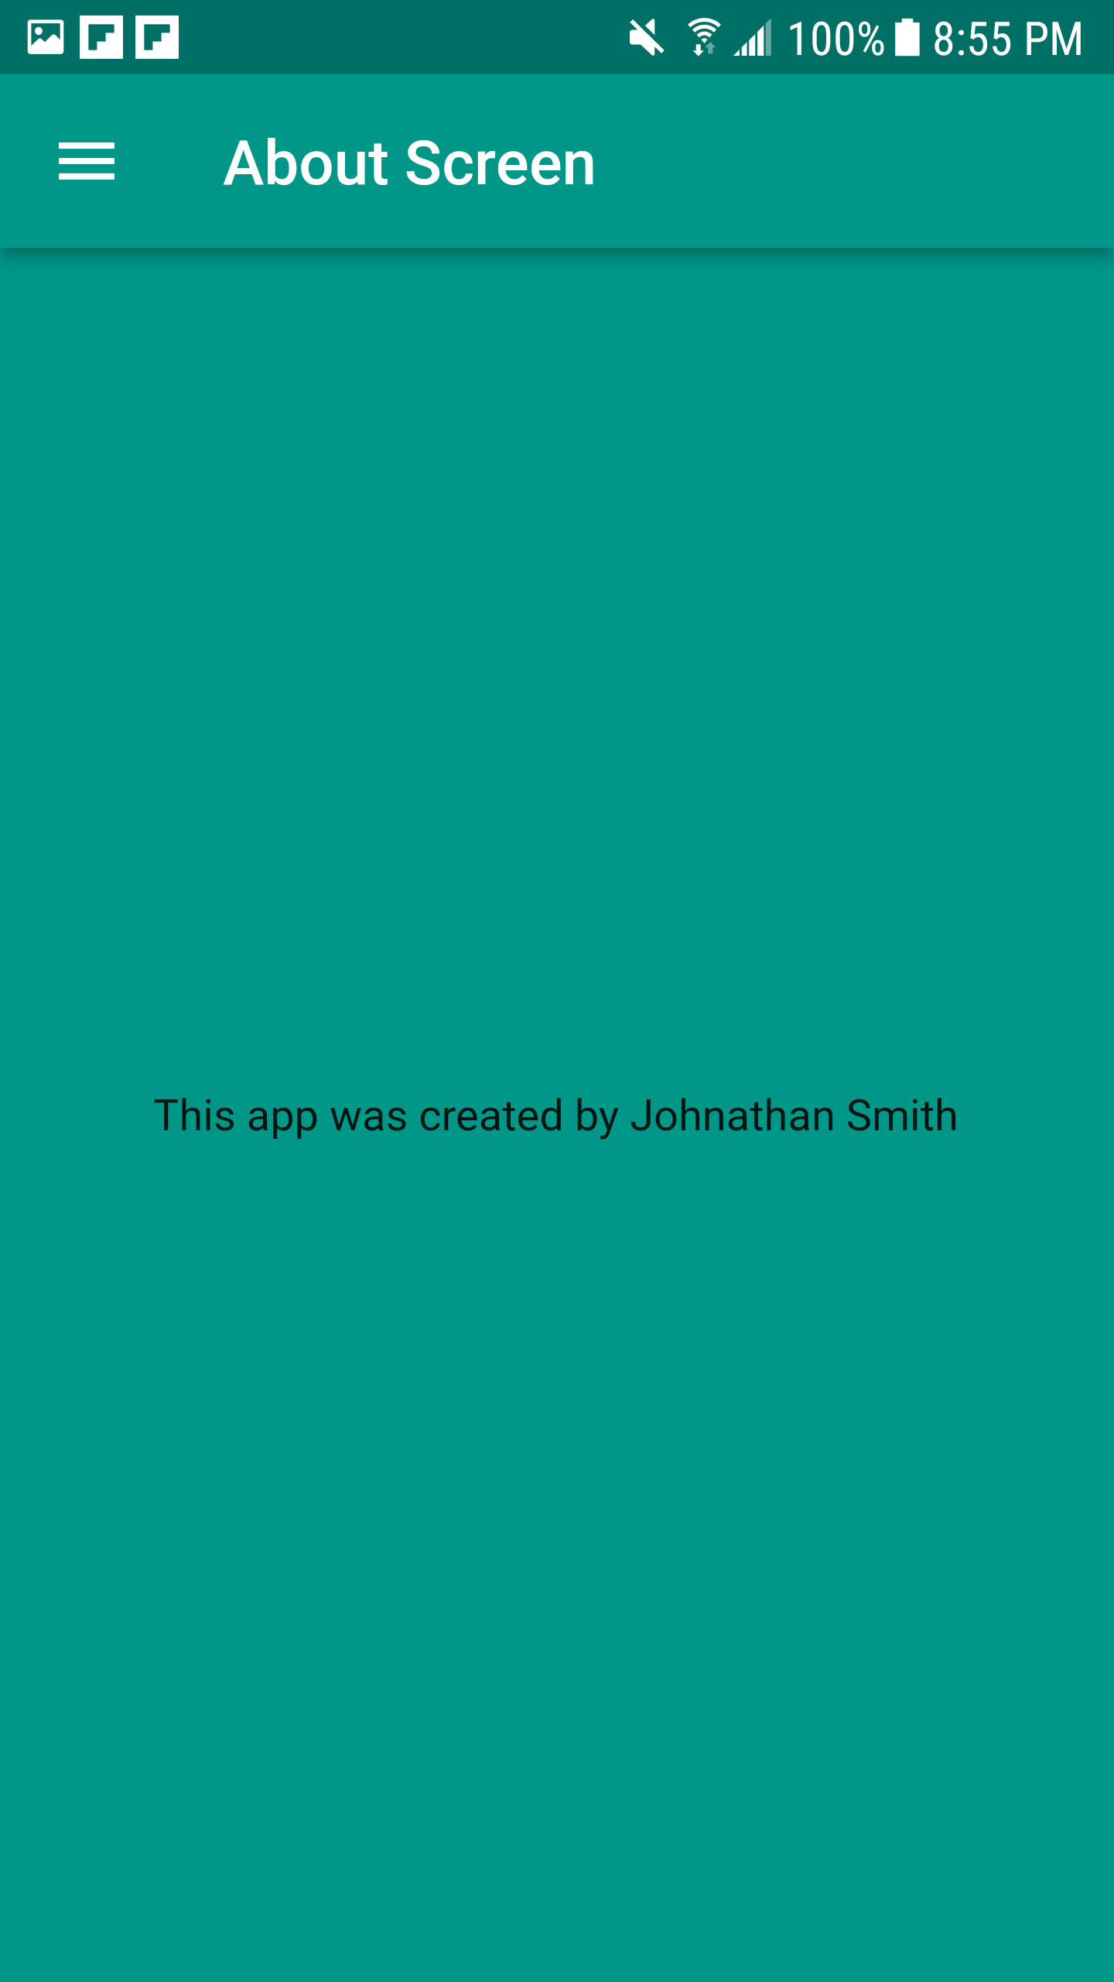
Location services being asked
For the user
The Home screen of the
App viewing the interactive
Map and list of sites
Drawer that gives you access
To the different pages of the
App. Also user information
He about page for the app

Slide 4
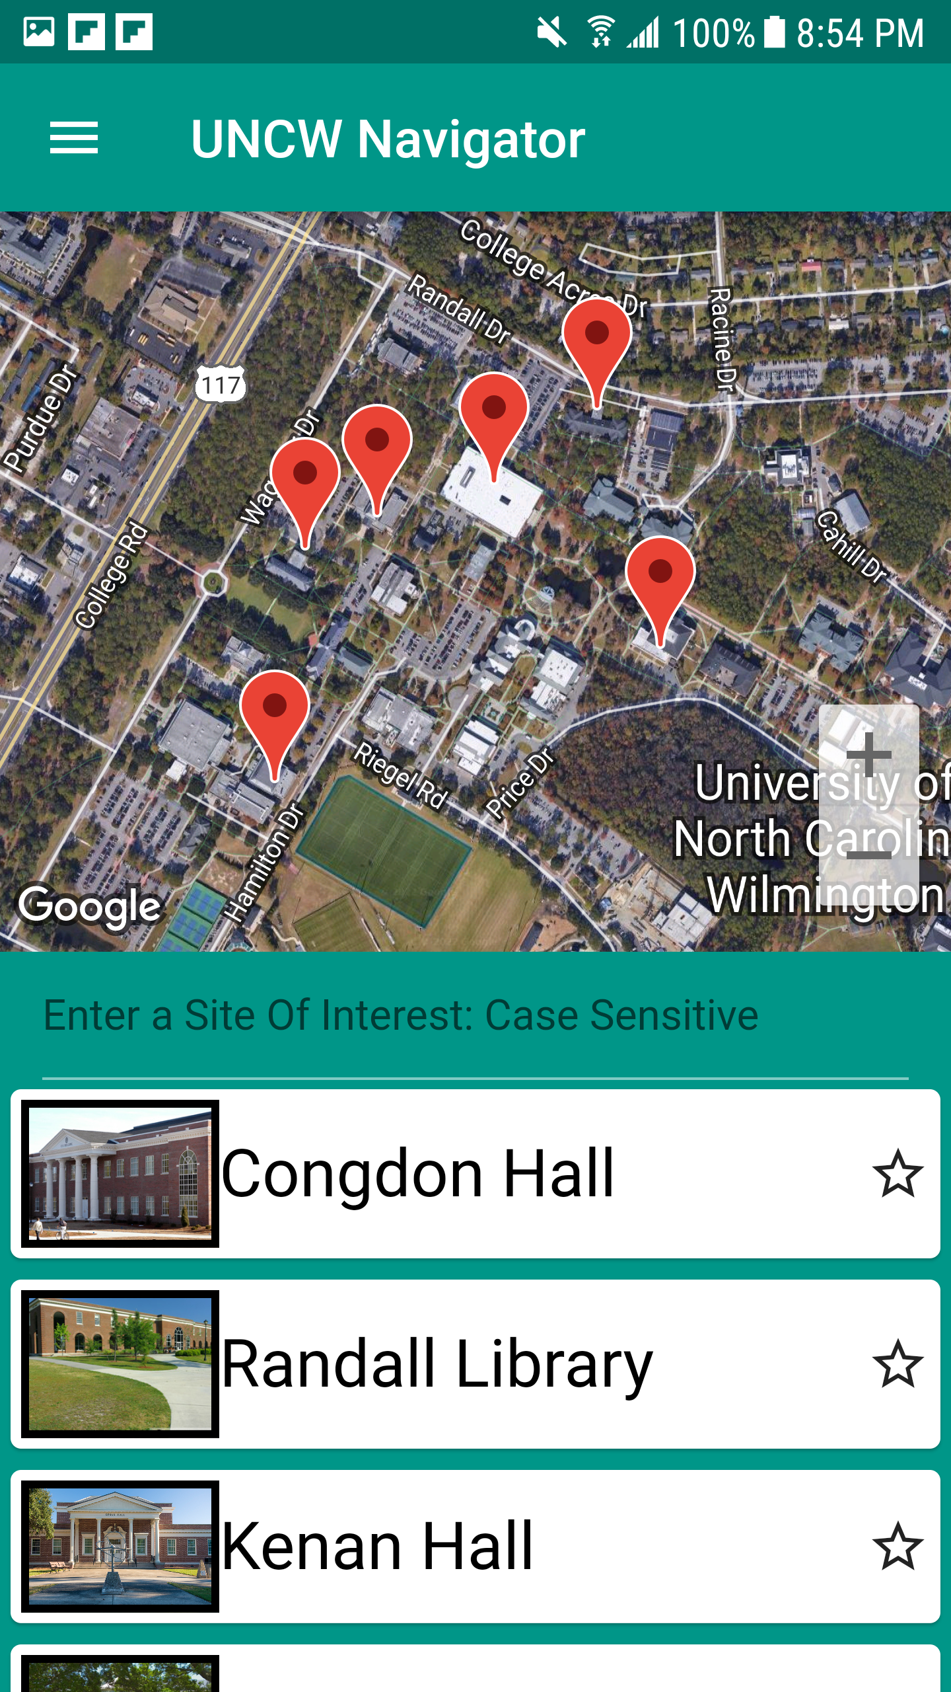
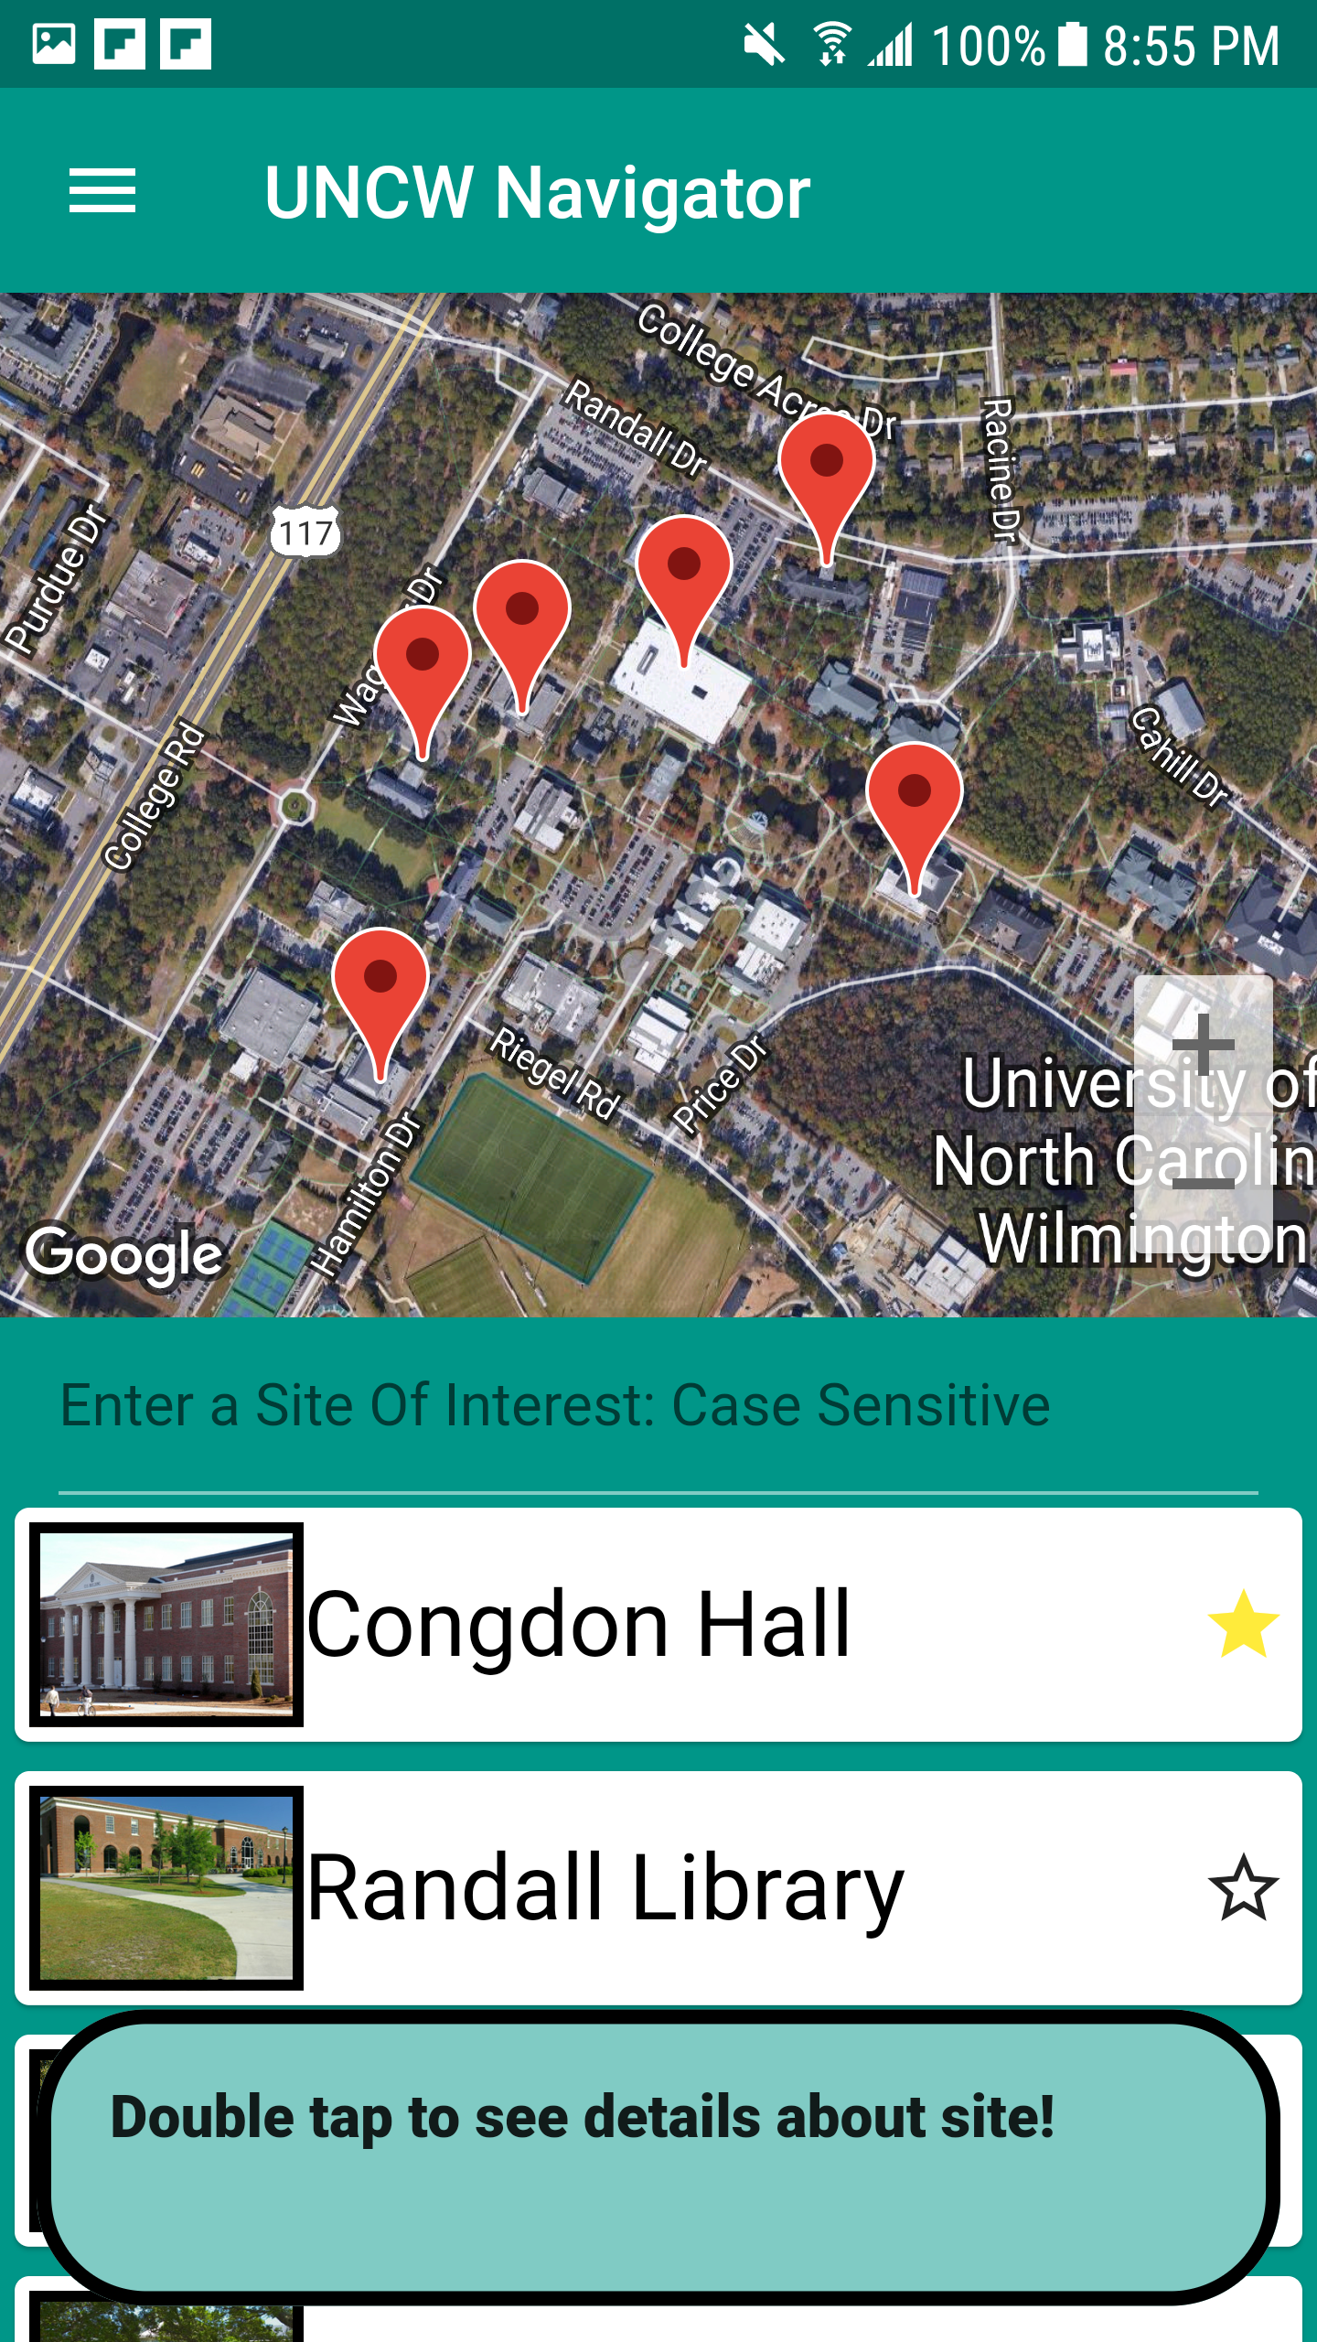
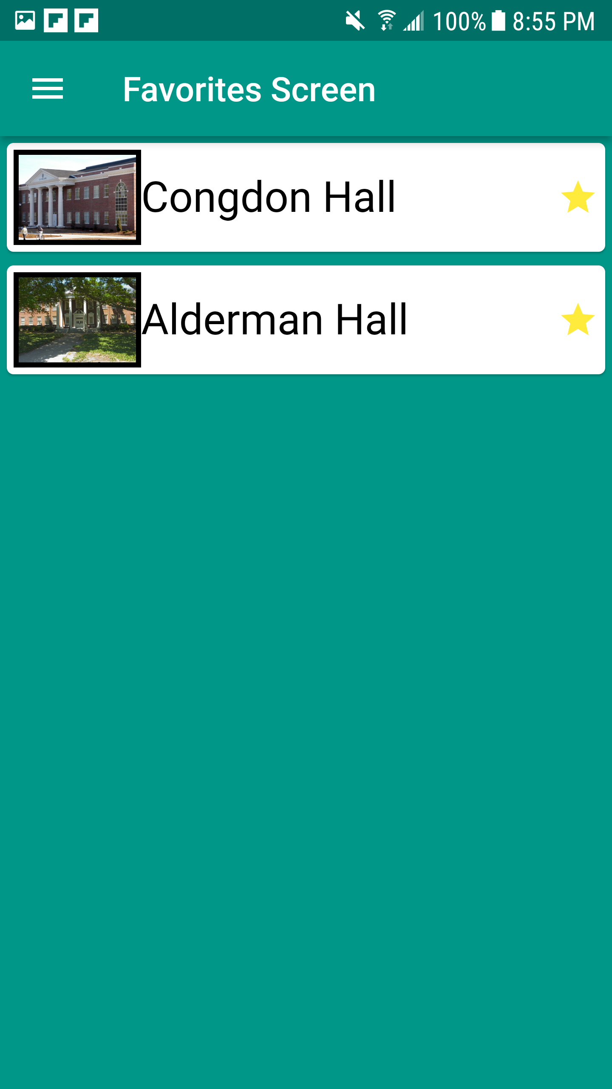
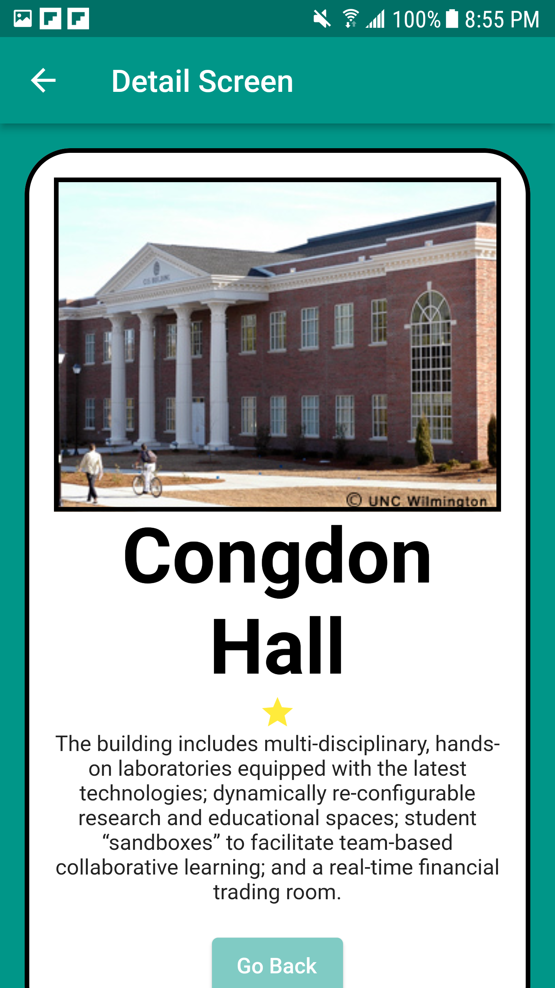
The home screen with no
Favorited sites
The Home screen after
Favoriting a site
(single click)
The favorites Page which allows for removing them by
Clicking them
The description page for a sight
Accessed by double clicking
A site.

Slide 5
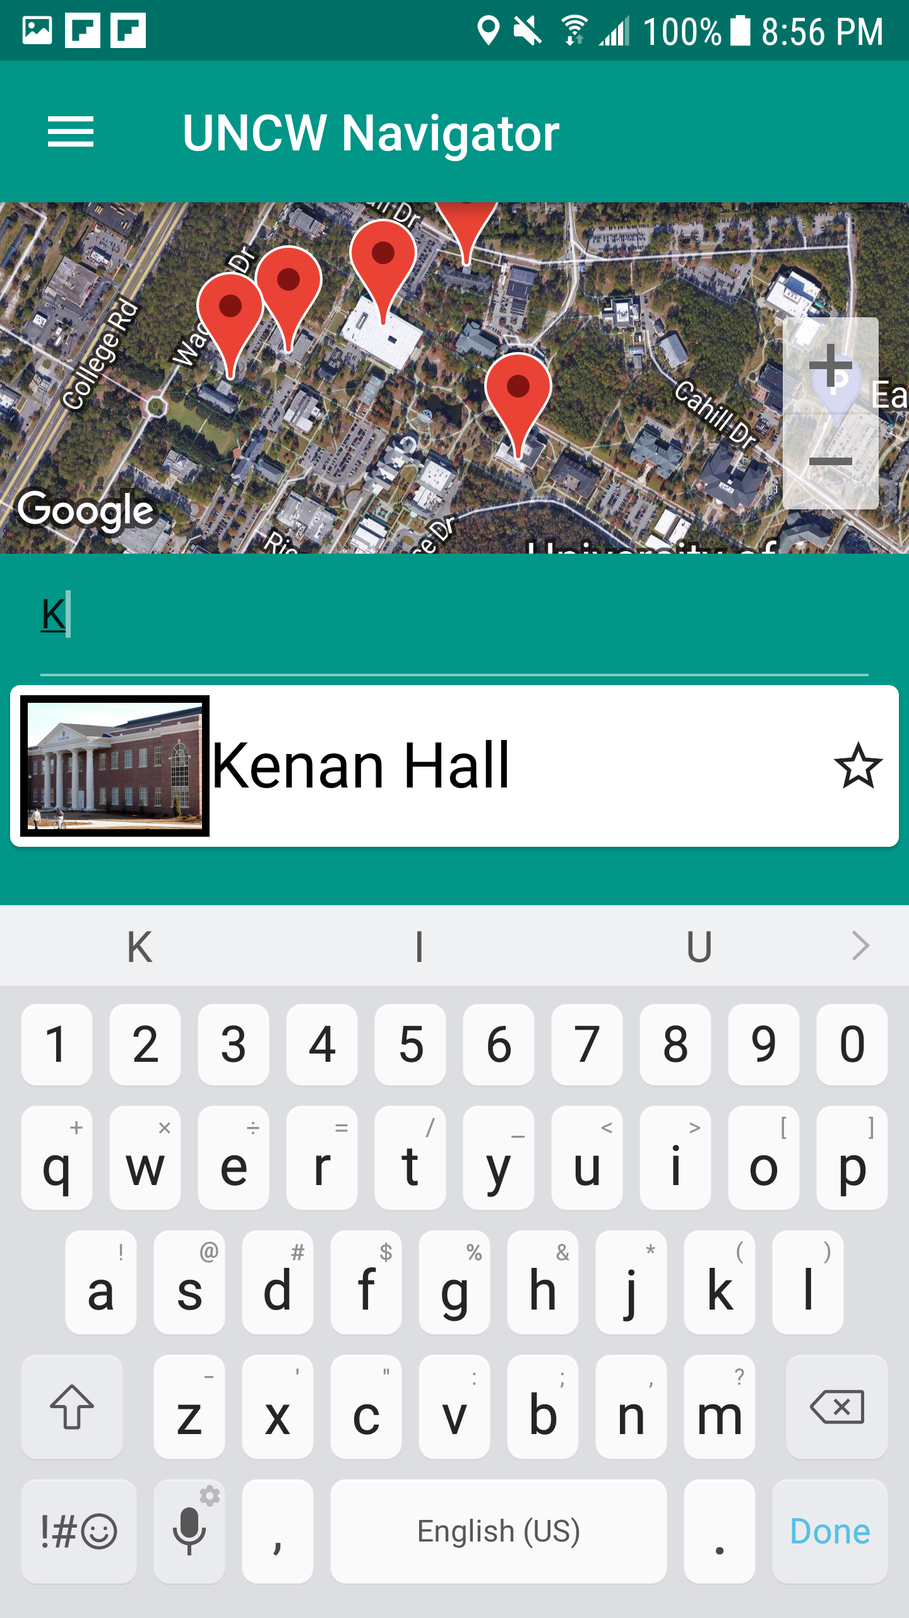
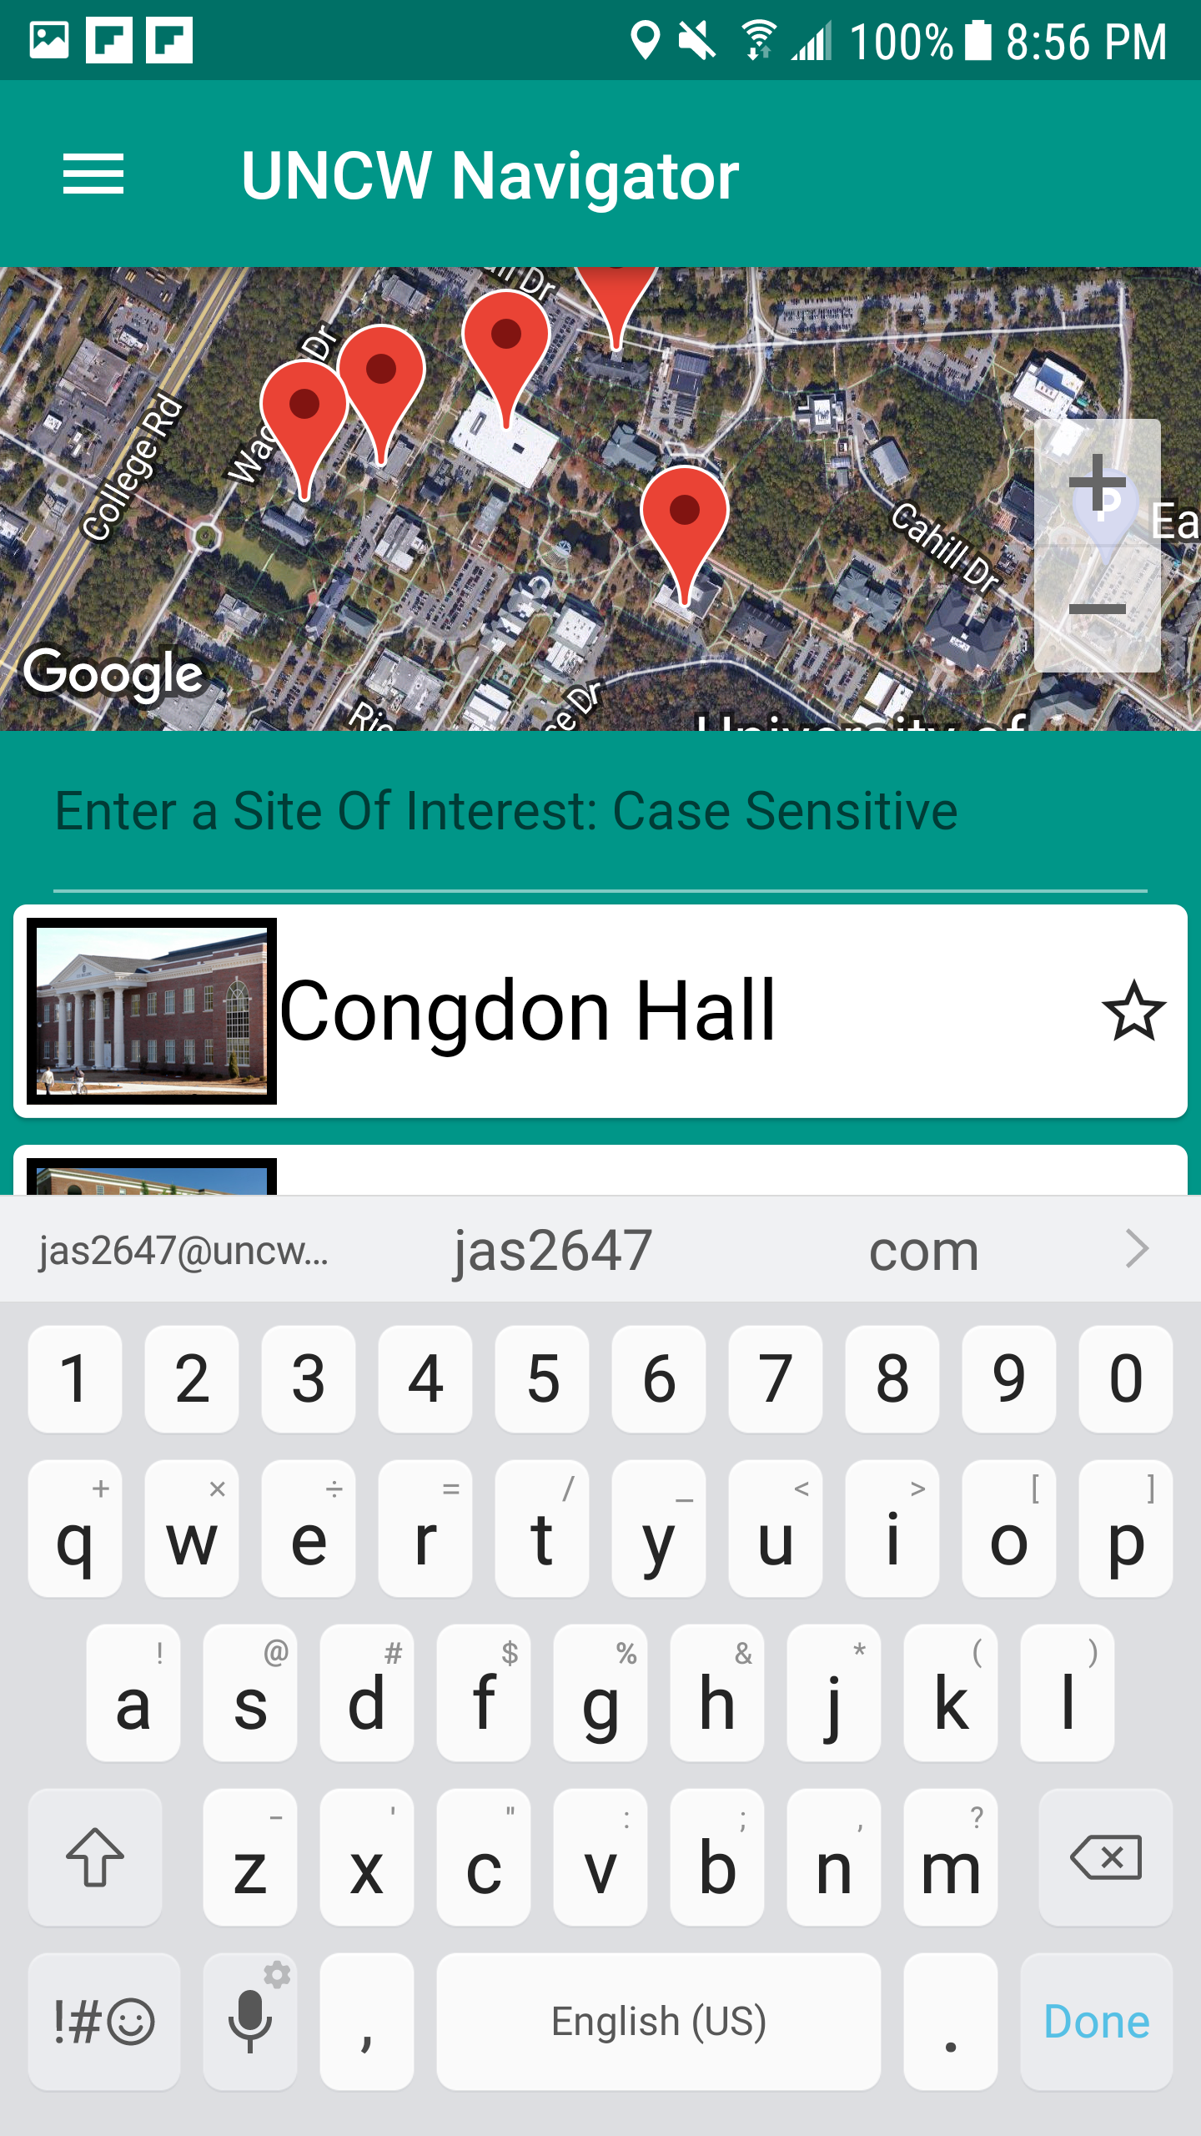

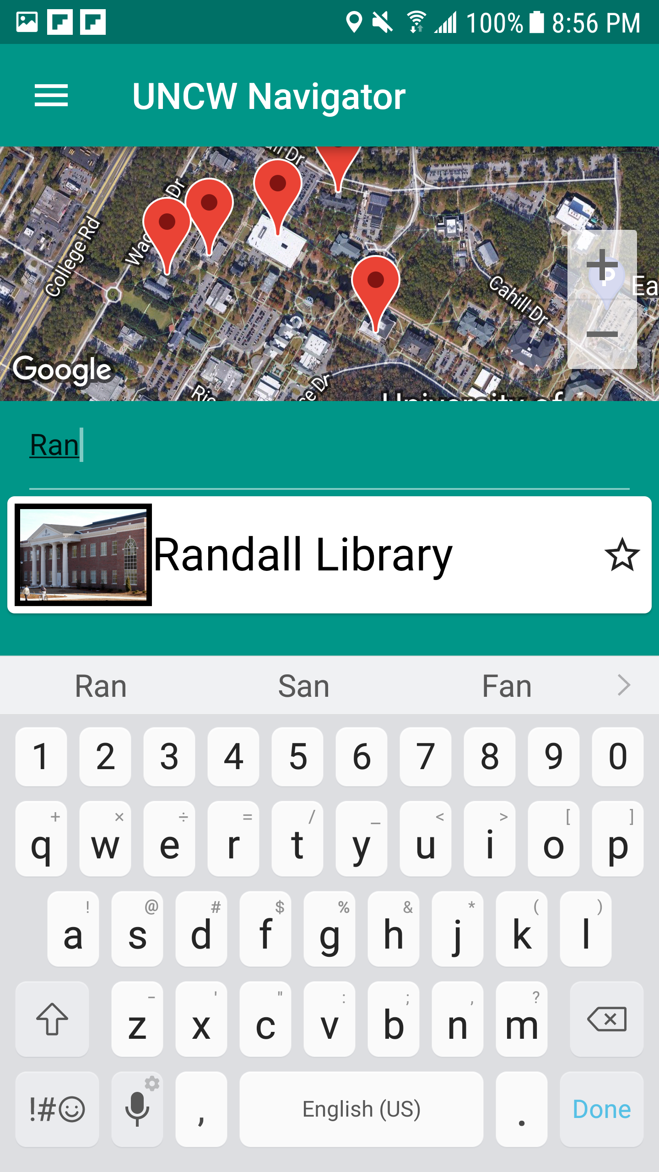
The searching function being used to search for sights by there names. Does not need to be exact and will update the list with appropriate sights.

